Slide 1
Towards Distributed Image Reconstruction

Slide 2
Radio Astronomy

Slide 3
SKA

Slide 4
Large Amount of Data

Slide 5
Hardware / Software

Slide 6
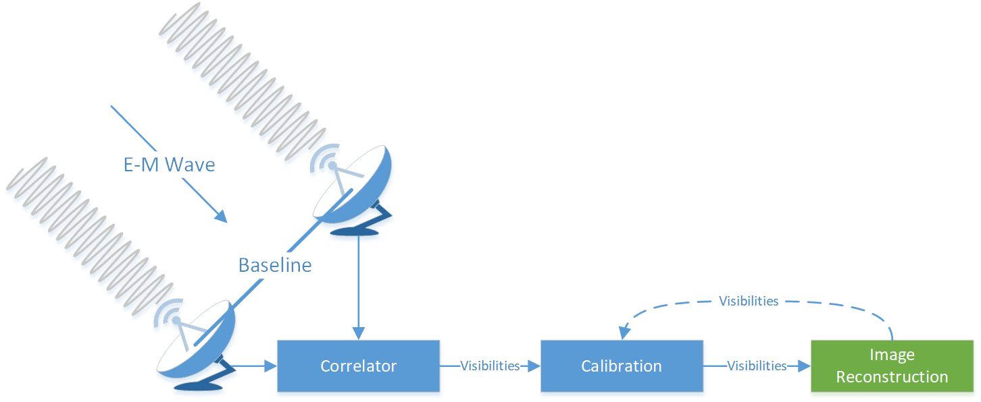
Radio Interferometry System

Slide 7
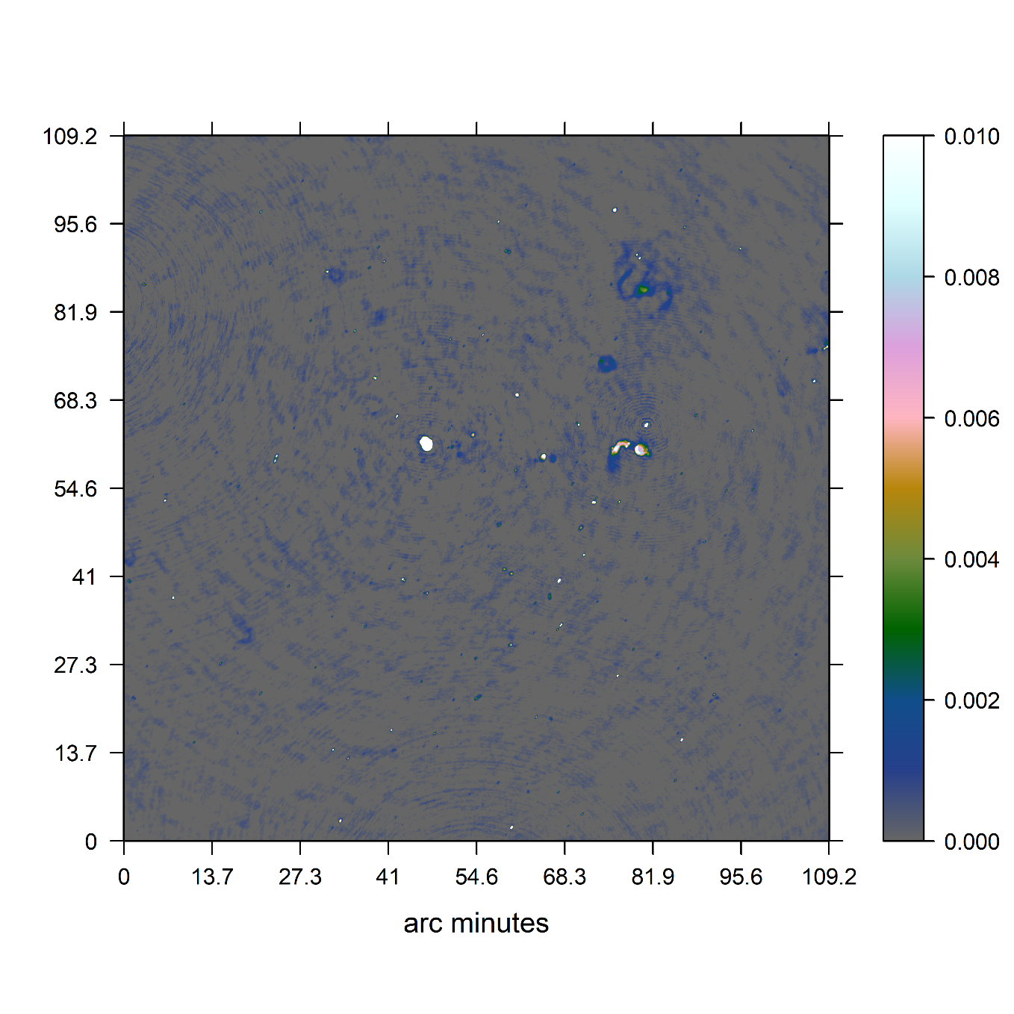
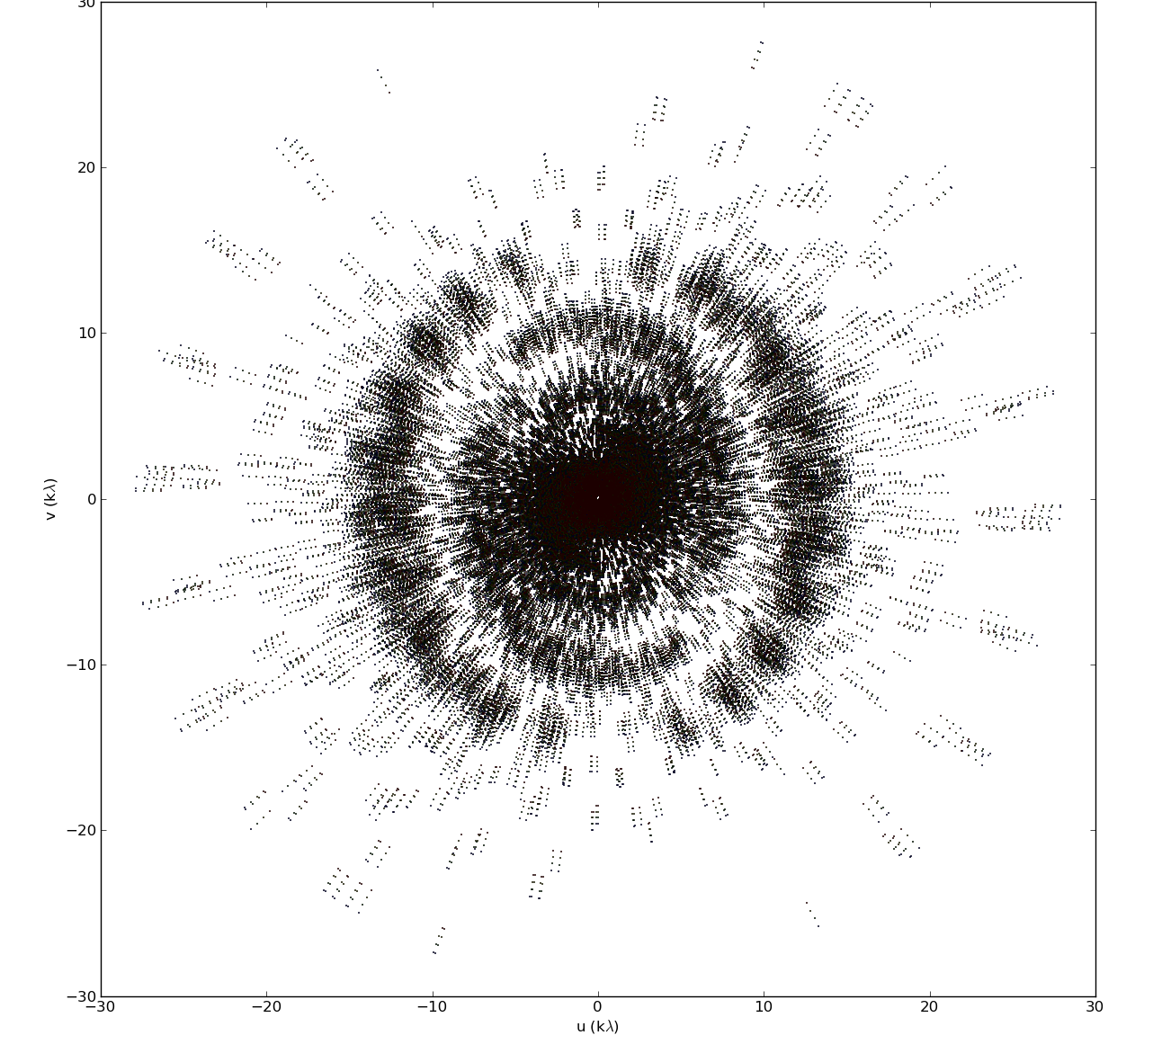
Image Reconstruction

Slide 10
Major / Minor Cycle

Slide 11
Major / Minor Cycle
~ 4 GB
32k * 32k image
< 1%
Non-Zero Pixels
Terabytes <<

Slide 12
Distribute Gridding!

Slide 13
Distribute Gridding!
May let us keep the calibrated Visibilities in-memory
New Gridders like IDG use GPU acceleration
But:
All other nodes idle during deconvolution
Deconvolution may become the most time consuming step

Slide 14
Can we use the idling nodes?
Repeat as little work as possible
Communicate as little as possible
Data Dependant factors

Slide 15
Data Dependant factors
How large is the grid vs. the calibrated Visibilities
How sparse is the model image
How large is the PSF
What is the dynamic range of the image
…
Test on a real world MeerKAT observation

Slide 16
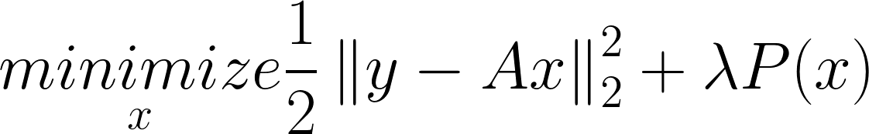
Compressed Sensing
Deconvolution == system of linear equations
Prior P() → ElasticNet
Optimization Algorithm → Coordinate Descent

Slide 17
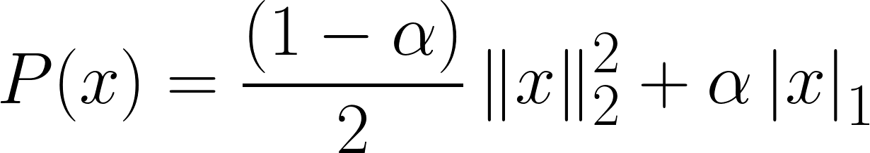
ElasticNet Prior
Mixture between L1 and L2 Norm

Slide 18
Coordinate Descent
Minimizes one Pixel at a time
Effective for high-dimensional problems
More sophisticated variants

Slide 19
Simple Distributed Deconvolution

Slide 20
Preliminary Results
Implemented in C# .netcore
1 Node vs 4 Nodes
Speedup of a factor 3.2

Slide 21
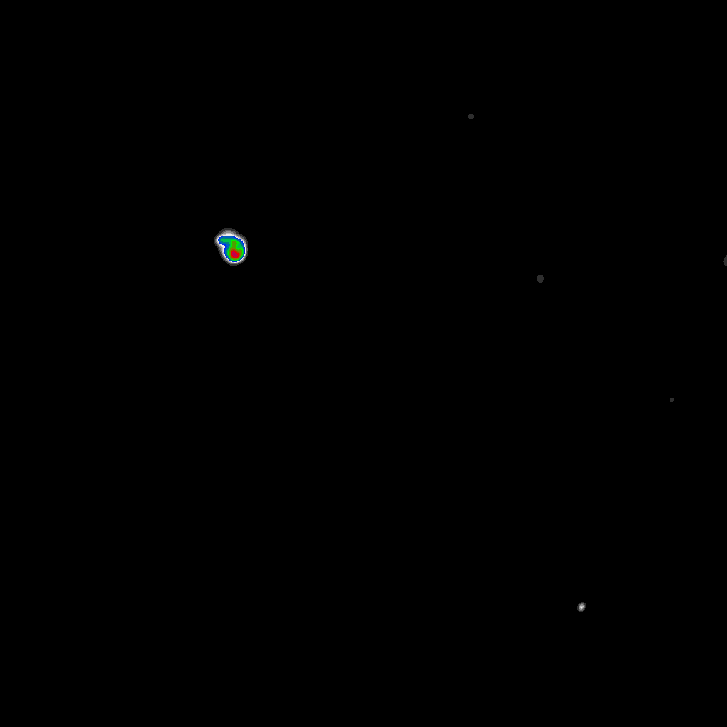

Preliminary Results

Slide 22
Limitations
Latency Limited
Proof of concept implementation (speedup factor is inaccurate)
Data volume not (yet) representative

Slide 23
Opportunities
CD deconvolution with GPU acceleration
More sophisticated CD algorithms, but viability depends on the PSF

Slide 24
Next Steps
GPU Acceleration for Coordinate Descent
Test on Azure Cloud
MORE DATA

